Slide 1



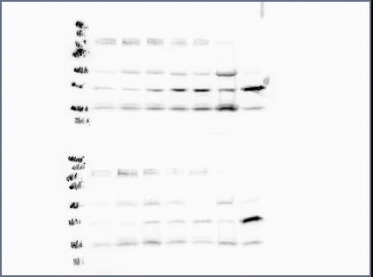
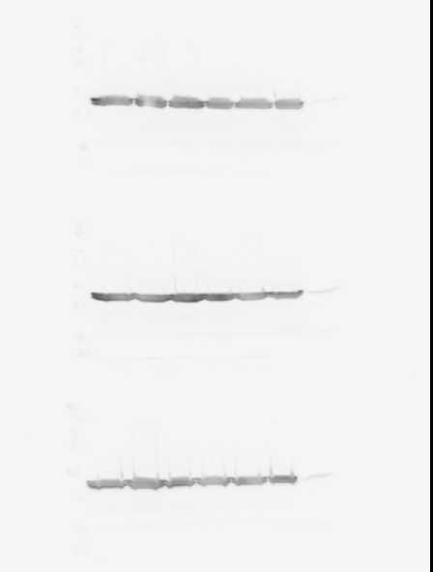
#.##
Session # here (delete this text afterwards)
Title
Author(s)
Affiliations
Introduction
Methods & Objectives
This slide/poster size is 40.97” x 23.04” (16:9 aspect ratio)
Minimum font: 28pt (this may seem large, but at this poster size it’s not)
Recommended font Types: Calibri, Arial, Times New Roman
This is only a template. All content may be modified
Layout should always be in landscape orientation
Save all mathematical formulas and equations to images (.jpg, .png) when embedding or upload your excel file along with your PowerPoint file.
Export this file as a .png
Western Blot
PLSCR1
36kd
Actin
46kd
Time (Hours)
Results
This PowerPoint 2011 template produces a 40.97” X 23.04” presentation poster. You can use it to create your research poster and save valuable time placing titles, subtitles, text, and graphics.
Images
Images
Conclusions
References & Acknowledgements
Provide a succinct conclusion of your findings here.
Thanks to whomever should be acknowledged in this research.
Reference A
Reference B
Reference C
MARC Poster Session 01/25/22-01/26/22
Notes:
Single sided poster!

